Slide 1
MWWP Demo Creating a Drama
Jezabel N. Muñoz Cortés
June 14, 2011

Slide 2
Biography
BA from the University of Puerto Rico at Aguadilla.
English as a Second Language
Secondary Education
First year teacher
First Bilingual Preparatory School
Located at Barrio Camaseyes, Aguadilla.
one group per grade
does not exceed 20 students per group.
6th grade
All subjects, except for Science
9th & 10th grade
Computer Science

Slide 3
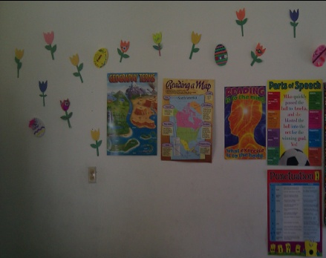
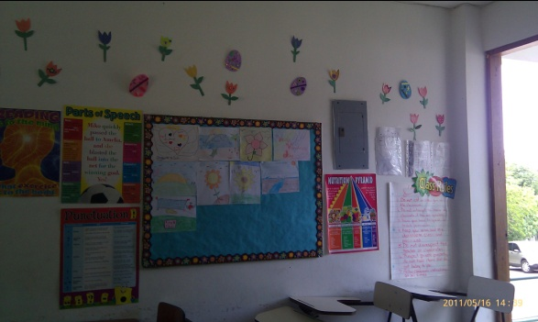
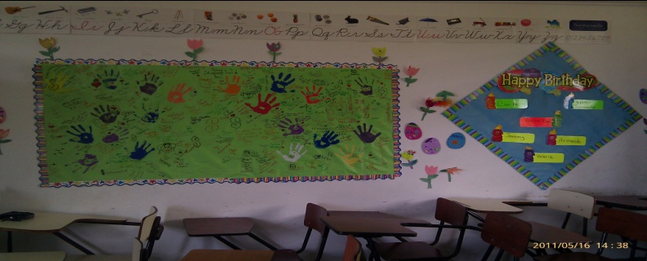
My Classroom
I had from 19 to 20 students.
13 girls
7 boys.
It was small, but colorful.
Welcoming and relaxed environment
No computer
Message Wall
Student’s work

Slide 4
Educational Philosophy
I believe in student centered classrooms, where the teacher is a guide who helps create their own knowledge, who motivates them to become life long learners and value the importance of educating oneself.
I believe that students learn in different ways (multiple intelligences; H. Gardner) and as an educator one must keep that in mind when creating or giving a class.
I believe in application or in learning by doing (J. Dewey).

Slide 5
Philosophies and Theories that Influence My Teaching
Progressivism Ideas should be tested by active experimentation. Learning rooted in questions of learners in interaction with others. Experience and student centered. J. Dewey
Cognitivism/ Constructivism Learner actively constructs own understandings of reality through interaction with environment and reflection on actions. Student-centered learning around conflicts to present knowing structures. J. Piaget

Slide 6
Philosophies and Theories that Influence My Teaching
Humanism Personal freedom, choice, responsibility. Achievement motivation towards highest levels. Control of own destiny. Child centered. Interaction with others. A. Maslow
Reconstructionism/ Critical Theory Critical pedagogy: Analysis of world events, controversial issues and diversity to provide vision for better world and social change. P. Freire

Slide 7
Background on Lesson
During the year students showed lack of interest in writing. They would get bored with the writing prompts but mostly the problem was individual writing and the writing process.
After the reading of a drama, they were placed in pairs and created their own adventure drama.

Slide 8
DE Grade – Level Expectations
W.6.4 – Identifies elements in descriptive, narrative, and expository forms of writing; uses a variety of sentence types and basic organizational patterns to construct narrative, descriptive, and expository paragraphs.
W.6.5 – Uses the writing process; applies prewriting strategies to generate ideas; uses the dictionary as an aid in the writing process; identifies spelling, capitalization, and ending punctuation errors.

Slide 9
Creating a Drama
Before reading the drama, students along with the teacher as guide, will identify the difference between a drama and a story, and identify characteristics/elements.
What is a drama? What makes it different from a story or novel? What does it have in common with a story or novel?
Definition
Characteristics of a drama
After reading “Elizabeth Blackwell: Medical Pioneer” by Joanna Halpert Kraus, students will pair up and begin to work on their drama map. They will select the setting (time, place), characters (from 1 to 3), plot (events, conflict, resolution).
Story Map

Slide 10
Materials/Time
Material
Time Needed
Graphic Organizer
Story Map
Outline
Venn Diagram
Drama to model
Example: After reading the drama Elizabeth Blackwell: Medical Pioneer from their text books, students used it to model their writings.
Able to complete this lesson in one week, taking two class periods (Reading and Language)
For maximum results, I suggest more time to allow for dramatization.

Slide 11
Instructions
Part One
Part Two
In pairs, read Elizabeth Blackwell: Medical Pioneer by Joanna Halpert Kraus
Now create your own scene using the story map.
Brainstorm about setting, characters, etc.
Begin writing your first scene.
Remember to distinguish the curtain rising, the setting of the stage (stage left the barren house); to identify the cast or characters.
example: The Cast of Characters includes a Narrator; Elizabeth Blackwell, a premedical student…

Slide 12
Reminder
Your first scene should:
Introduce your characters
Specify the setting
Give background knowledge
Lead up to the conflict, but don’t give it away!
Foreshadowing
Flashback
Any other technique to give the audience a clue something is going to happen.

Slide 13
You have about 35 to 40 minutes to write your first scene.
Quote from Jim Purdy’s Effective Approaches to Peer Writing
“Writing is almost always collaborative. Hardly anything written, be it literary or transactional, is the work from one person from beginning to end.” (Leahy 46)

Slide 14
Literary Resources
Peer Writing
http://www.schreyerinstitute.psu.edu/pdf/alex/peer_write.pdf
Teaching Writing with Peer Response Groups. Encouraging Revision
http://www.ericdigests.org/pre-9211/peer.htm
Effective Approaches to Peer Writing Workshops
by Jim Purdy
http://prezi.com/-_uof0zyxswc/effective-approaches-to-peer-writing-workshops/
Pedagogy and Theater of the Oppressed – A. Boal
http://www.ptoweb.org/boal.html

Slide 15
Resources
Handouts
Assessment
Story Map
graphic organizer at http://www.eduplace.com/graphicorganizer/pdf/storymap1_eng.pdf
Houghton Mifflin Harcourt Education Place
Characteristics of a Drama
http://www.esds1.pt/site/images/stories/isacosta/secondary_pages/Reading%20&%20Writing/WRITING_Genre_Characteristics.pdf
Creating a Drama Rubric

Slide 16
The Author’s chair
Three volunteers please.

Slide 17
Questions?
Feedback

Slide 18
A drama, or play, is written to be acted for an audience. It allows for plot advancement through dialogue.
Definition found Reading Street Volume 2 page 376 student edition.

