Slide 1
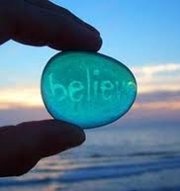
“This I ”
Marylian Rivera Villanueva
Graduate Student
Teaching Assistant
UPR-Mayaguez

Slide 2
About Marylian…
I graduated from the University of Puerto Rico in Mayaguez with a bachelors in English Literature and a teaching certification in secondary education.
I am currently undergoing my graduate studies in English Education in the UPR-Mayaguez.
I am a teaching assistant in the UPR-Mayaguez, here I have taught English 3202-01, English Composition and Writing I & II.
I’ve been teaching for three years.

Slide 3
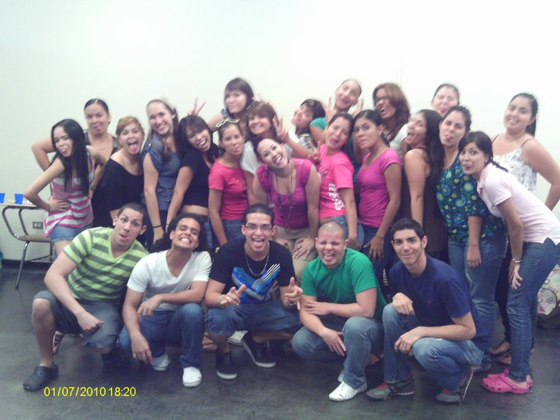
My Classroom
27-29 students
Blackboards
One computer and projector
Internet access.

Slide 4
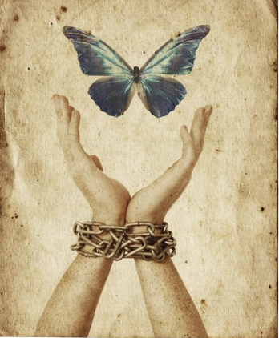
My teaching philosophy
I believe in Paulo Freire’s Critical Pedagogy.
I wish to educate for a social change.
My prime goal is to encourage students to “take on the role of the subject of the act” (Reading Paulo Freire, 1994) and no longer the object; showing them that they can transform society with their own thinking and their writings.
Transcend the simple state of transmitting mere knowledge and provide a learning experience which is student centered.

Slide 5
When teaching writing…
“ We learn how to write when we react vigorously to what we have written, discovering in the process that we are able either to improve our writing or feel satisfied with what we have written.”
(Freire, Letters to Cristina)

Slide 6
One day my classroom…
Frist day of class starts with a presentation titled English is NOT my First Language” (https://moodle.uprm.edu/course/view.php?id=838)
The purpose of this presentation is to show students all of the advantages they posses by having Spanish as their first language.
Then, they are presented with a motivational video (http://www.youtube.com/watch?v=X_XW6Y-K3QE)
After watching the video, students write a short reaction. (https://moodle.uprm.edu/mod/assignment/submissions.php?id=31890&userid=12076&mode=single&offset=4)

Slide 7
What is an I Believe writing
It all started in 1951 when Edward R.
Murrow hosted a This I Believe section
in a radio program.
On this broadcast, people, both well known
and unknown read five-minute essays about their personal
philosophy of life.
They shared insights about individual values that shaped their daily actions.
The first volume of This I Believe essays, published in 1952, sold 300,000 copies more than any other book in the U. S. during that year except for the Bible.

Slide 8
Continue
50 years later, NPR is inviting people of all ages and all perspectives to examine their belief systems and then write a 350–500 word personal essay.
The web page contains a curricula that has been designed to help teachers seize this exciting opportunity to motivate students to write for an authentic purpose to real-world audiences.
An author’s note in the This I Believe college curriculum states that students have be taught that good writers never, under any circumstances, use first-person pronouns. Students believe that their point of view should be avoided or obscured in academic writing whenever possible.
As a result, This I Believe project uses the I of the essay to focus on the subject itself.

Slide 9
Aligned to the Content Standards
Listening/Speaking
L/S.12.4 Expresses thoughts and opinions to evaluate text, debate current events, concepts, and literary elements; makes predictions and inferences, as well as draws conclusions from listening to a variety of texts, performances, and multimedia sources; listens to sort and prioritize information.
Writing
W.12.3 Uses creative writing styles to produce poems and other literary forms.

Slide 10
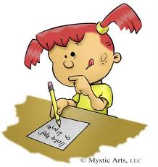
Hands on!
Listen to various podcasts in the This I believe section of the NPR site.
Be Cool to the Pizza Dude Always Go to the Funeral
Discuss about the different beliefs people have.
Brainstorm to find our your belief. (create a list, a cluster, ask questions, free write, etc)
Organize your writing and create a 350 word I Believe statement.

Slide 11
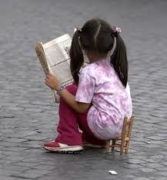
Now… The Authors Chair

Slide 12
Questions or comments?

